Slide 1



Testing your API using Postman
Rob DeRosia
@aisored

Slide 2

A quick poll…
Notes:
How many of you have used Postman before?
… keep your hands raised …
How many of you have used Postman for more than sending one-off requests and viewing the response?
… keep your hands raised …
How many of you have written automated tests using Postman before?

Slide 3


Still using the Chrome extension?

Slide 4
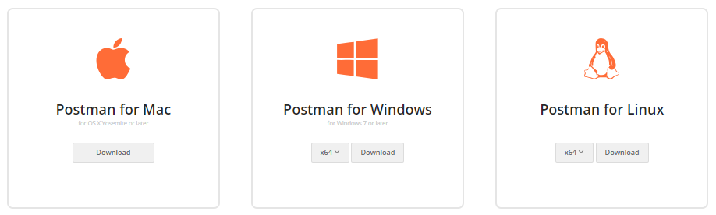
getpostman.com
Notes:
The Google Chrome App is deprecated. There are native apps you can download from getpostman.com.

Slide 5
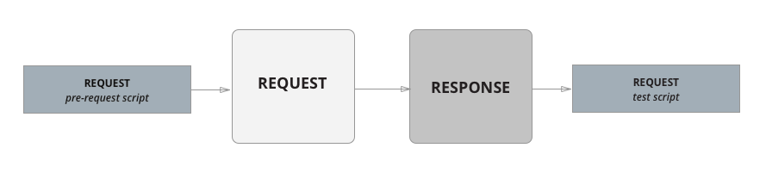

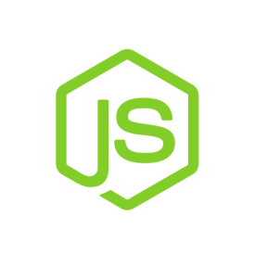
Introduction to Scripts
Notes:
Scripts in Postman
Postman contains a runtime based on Node.js that allows you to add dynamic behavior to requests and collections. This allows us to write test suites, build requests that can contain dynamic parameters, and pass data between requests. You can add JavaScript that can be executed at two different stages in the flow:
Before a request is sent to the server, as a pre-request script under the Pre-request Script tab.
After a response is received, as a test script under the Tests tab.
Users can add pre-request and test scripts to a collection, a folder, a request within a collection, or a request not saved to a collection.
In Postman, the script execution order for a single request looks like this:
A pre-request script associated with a request will execute before the request is sent
A test script associated with a request will execute after the request is sent

Slide 6


pm.* API
pm.test()
Function with 2 parameters
Test name
Boolean function
pm.expect()
Chai JS
pm.response.*
Notes:
pm.test()
The pm.test() function is used to write test scripts inside the Postman test sandbox and accepts two parameters, the name of the test (as a string) and a function to return a boolean value.
pm.expect()
The pm.expect() function was built on ChaiJS and allows us to deal with assertions of data from a response.
pm.response.*
The pm.resonse object provides shorthands for response-based checks, like status codes and response bodies.

Slide 7

Demo
Notes:
Introduce the Seinfeld Quotes API: 4 methods (GET all, GET by Id, POST, and DELETE)

Slide 8
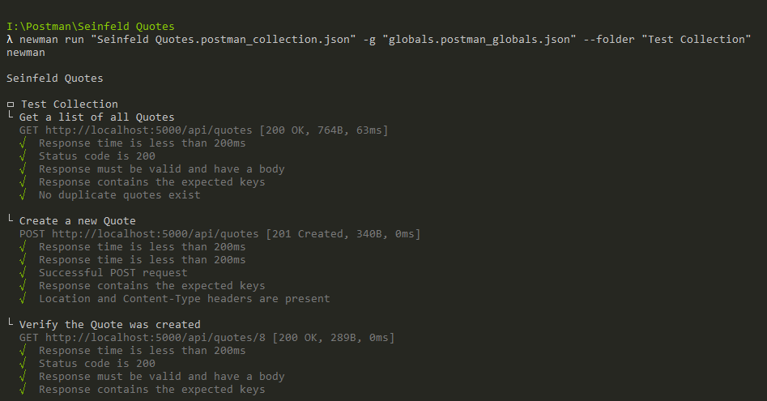

Hello, Newman
Notes:
Newman is a command line Collection Runner for Postman built on Node.js. It allows us to run and test a Postman Collection directly from the command line, which means we can now easily integrate it with our continuous integration servers and build systems.

Slide 9

Thank you!
Rob DeRosia
@aisored

